Slide 1


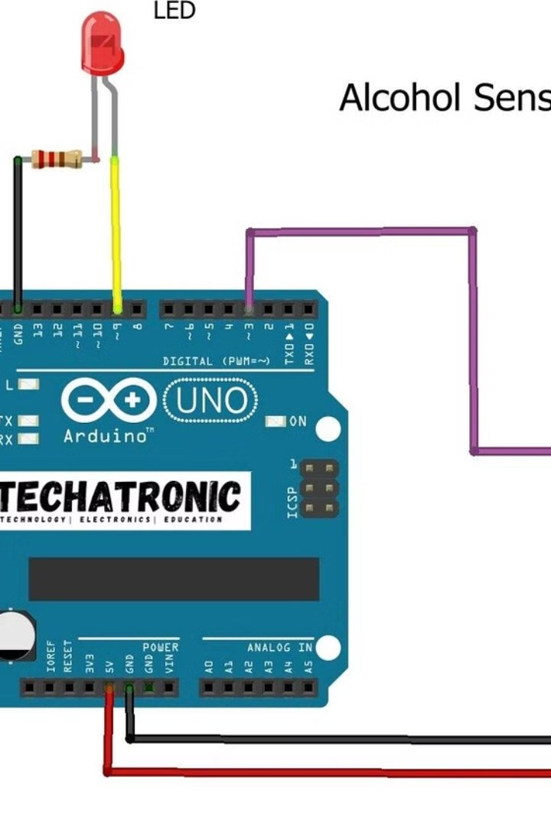
Intoxi-Lock Alcohol Detection and Engine Locking System
An innovative system using Arduino Uno and MQ3 sensor for accurate alcohol detection and engine locking.
Ta
by Team- 8
DEEPAK SAHU
SMARAK PATRA
PRITAM PRAKASH
SAURABH RAWAT
BIJAYA KETAN MOHAPATRA
Caption

Slide 2




Problem Statement:
Despite efforts to curb drunk driving, alcohol-impaired driving remains a significant cause of accidents worldwide.
Current enforcement methods like sobriety tests and breathalysers have limitations, relying on human intervention and lacking foolproof reliability. This project aims to address this critical issue by developing a robust Alcohol Detection System (ADS) integrated into vehicles
The ADS will accurately identify alcohol presence in the driver and promptly shut down the engine to prevent potential accidents, thereby enhancing road safety and saving lives.

Slide 3
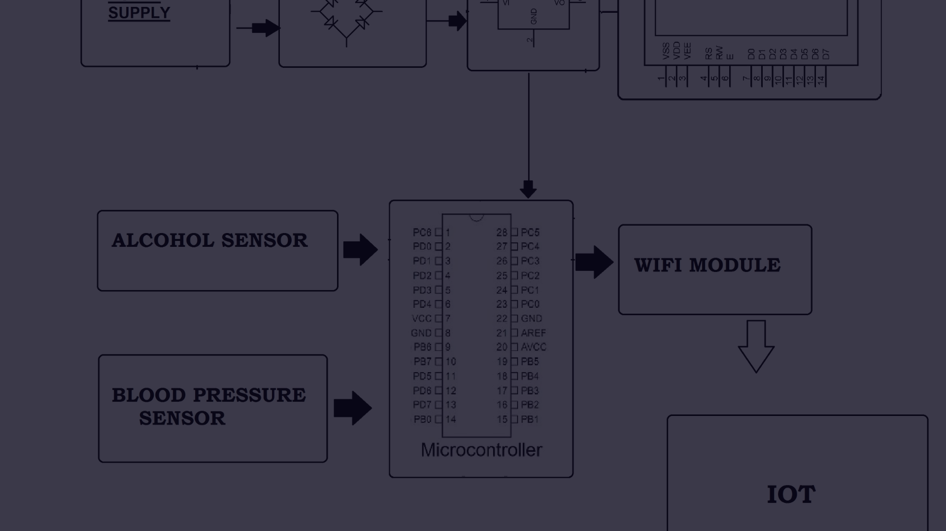
OBJECTIVES:
Develop robust alcohol detection technology:
Ensure real-time detection and response:
Integrate seamlessly with vehicle systems:
Design and implement sensors and algorithms capable of accurately and reliably detecting alcohol levels in the driver's breath or vicinity within the vehicle cabin.
Develop a responsive system that can promptly detect alcohol presence and initiate engine shutdown in real-time to prevent impaired driving situations without causing undue delay.
Create a solution that seamlessly integrates with the existing electronic architecture of vehicles, ensuring compatibility, safety, and reliability while minimizing interference with other critical vehicle functions.

Slide 4
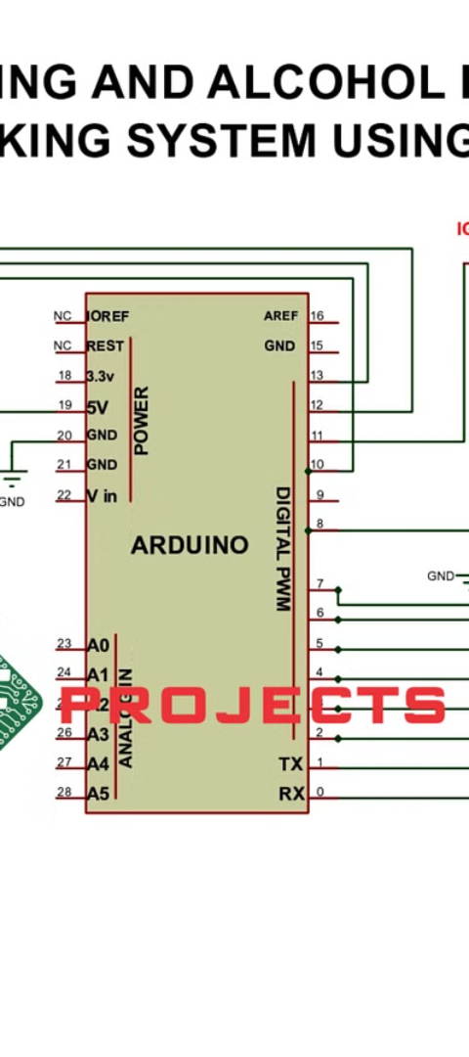
Working Principle of the Alcohol Detection System
1
Gas Sensing
2
Output Signal
The MQ3 sensor detects alcohol concentration in the surrounding environment.
The sensor provides a signal to the Arduino Uno for processing.
3
Threshold Detection
The system triggers engine locking if alcohol level exceeds a set threshold.
Caption

Slide 5

Components:
Transistors (BC547 )
Patch Cords
Arduino Uno
B.O. Motor
Battery
LEDs
1
2
3
4
5
6
7
8
9
10
11
MQ3 Alcohol Sensor
Resistors (220 ohm x2)
5v Relay
Buzzer
Switch

Slide 6
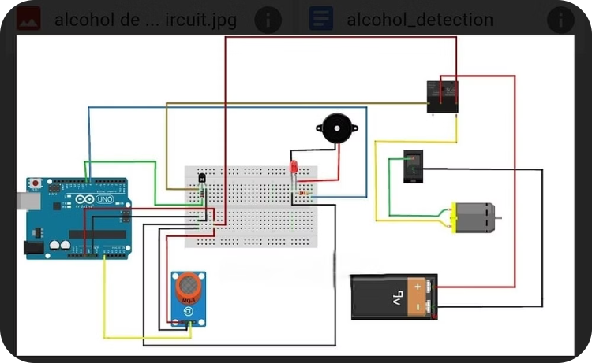
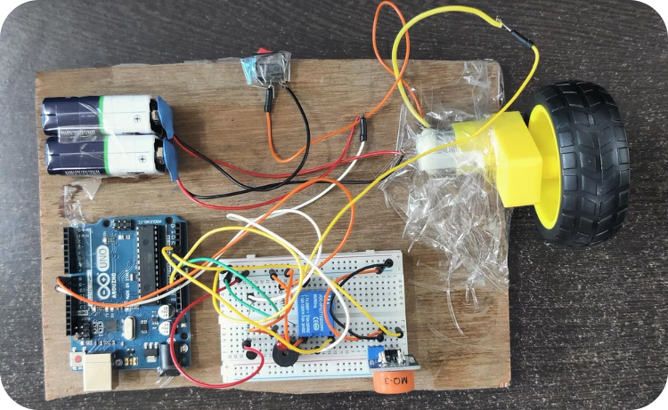
Circuit Diagram and Connections
Circuit Diagram
Arduino Uno Connections
An illustrative layout of the connections between Arduino, MQ3 sensor, and relay module.
An image showing the specific connection points and pin configurations of Arduino Uno.

Slide 7

Future Scope and Advancements:
1
Integration with Ignition System:
Devices Used: Relay module, microcontroller (e.g., Arduino), ignition system interface
Connect the relay module to the ignition system interface.
Program the microcontroller to send signals to the relay module based on alcohol detection.
Test the integrated system to ensure reliable prevention of vehicle starting upon alcohol detection.
2
Wireless Connectivity:
Devices Used: Bluetooth or Wi-Fi module, microcontroller (e.g., Arduino), smartphone.
Integrate the Bluetooth or Wi-Fi module into the ADS hardware.
Develop firmware/software to establish wireless communication and enable remote monitoring and control.
Test the wireless connectivity for reliability and security, ensuring seamless operation.
Caption

Slide 8

THANK YOU
Caption

